Slide 1

Next step: diagramming
As the saying goes:
Bonus! It helps show our client’s what we think they want!

Slide 2
WARNING:
Application diagrams WILL change as you code and realize you missed something
This is a graphical design to help us code (there should be no language specific stuff here)

Slide 3
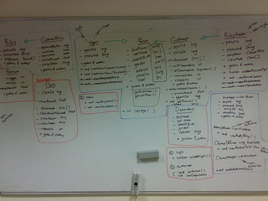
UML versus rough modeling
I’ll try to avoid full UML, BUT…
Rough drawing of what classes will be needed and how they connect are VERY common.
I’ve seen full WALLS of class-connection diagrams in software companies.
If you want to do full UML, go for it!

Slide 4
UML versus rough modeling
This class
A simplified version…
Basically, the minimum from UML so I can grade/understand these
Class
-----------
Attributes
--------
function or description of functions
Class
-----------
Attributes
--------
function or description of functions
*...*
Class
-----------
Attributes
--------
function or description of functions

Slide 5
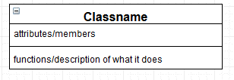
Notation: classes
This button is just a remnant from the software I used (draw.io)
Class name
This should match what you will eventually name the class
Attribute
Notation:
Name : Datatype
The data the class is working on. This includes state information
Mark arrays with []
Name : Datatype[]
Diagrams done with www.draw.io
For those who prefer text: https://plantuml.com/class-diagram

Slide 6
Notation: Functions
The major functions for the class
Alternatively, if you are early in the process, just a description of the class’s jobs/tasks
To state the return type:
Foo(name, name…) : datatype
Diagrams done with www.draw.io

Slide 7
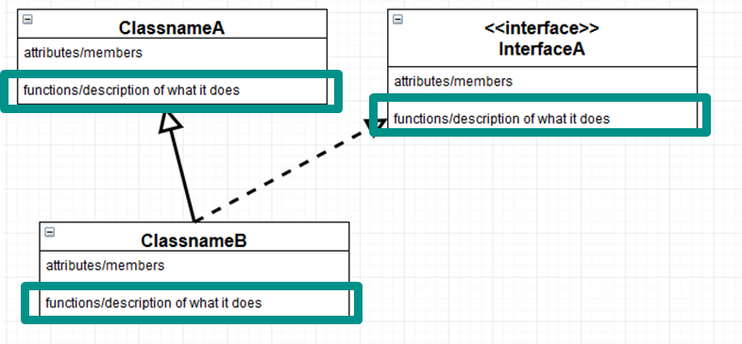
Notation: Functions
The first run of the diagram will normally be a description only
However…
If you KNOW you need it, add the function
If you KNOW you need it when working with other’s code (or people need yours), add the function
If you KNOW this will be needed for consistency, add the function

Slide 8
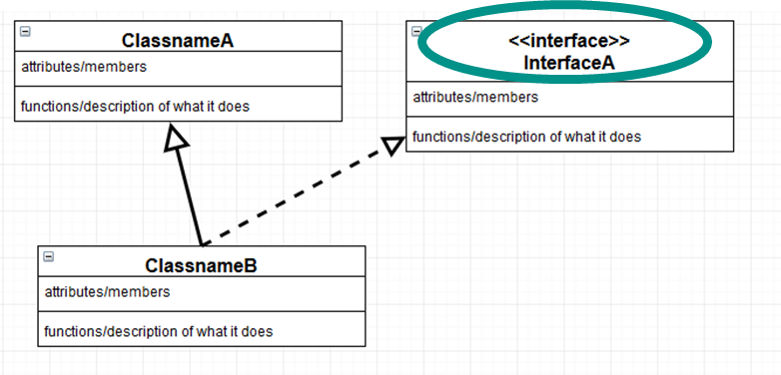
Notation: inheritance connections
Inheritance is shown with an arrow
Interfaces are tagged with <<interface>> or simply have the name in <<…>> (e.g. <<Animal>>). Ideally use a dashed arrow to show implementation (a solid arrow is OK)

Slide 9
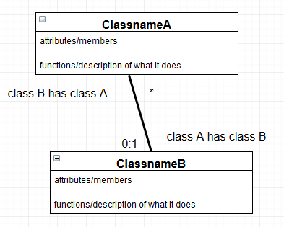
Notation: “has a” connections
A connection is shown with a line between two classes.
A connection has an optional “role” that describes the connection
The role of a class is on the far end of the line
Aside: True UML uses a large variety of different end caps

Slide 10
Notation: “has a” connections
A connection has a multiplicity (how many of a instances of a class that are owned).
1- just 1
0:1- 0 or 1
X:Y – X to Y instances
* - many
It is OK to have more than 1 connection between the same to classes
You MUST have a multiplicity or a very clear role. A role AND a multiplicity is better.

Slide 11
Notation: other info
Add additional notes if the diagram is not sufficient
E.g. private\public\protected is NOT mentioned
In UML these would be -, +, and # respectively
Abstract is also not mentioned and requires a note.
In UML it is italicized…but we can’t write italics by hand!
And more!
Make Abstract

Slide 12

Common errors
Variable “syntax”
I am training that variable syntax does not have to be the same way
so, x : int NOT int x;
This is preparation for Scala!
ALL collections use [], not list, not array, not vector
So x : int[] NOT x : vector<>

Slide 13
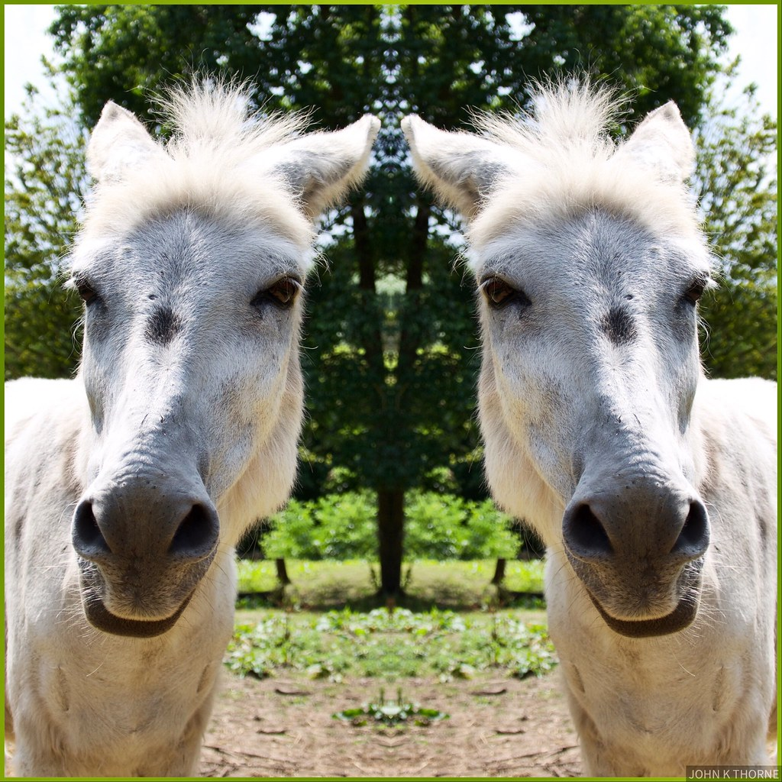
Common errors
Putting a connection line AND a member variable
This means adding that variable TWICE!
The reasons for the line rather than a member variable are
Displaying visually connection to check paths
Confirming the object is not a built in item, and needs to be made “here”
The ability to show what the connection class is, given the above

Slide 14
Back to checkers!
class CheckersProgram class Board class Square
Color: color class Piece Color: Boolean
class King
Let’s diagram this!
CheckersProgram
Board
Square
More stuff!

Slide 15
Back to checkers!
class CheckersProgram class Board class Square
color: color class Piece color: Boolean
class King
Attributes
CheckersProgram
Board
Square
Color : color
More stuff!

Slide 16
Back to checkers!
class CheckersProgram class Board class Square
color: color class Piece color: Boolean
class King
Links
CheckersProgram
Board
Square
Color : color
More stuff!

Slide 17
Back to checkers!
class CheckersProgram class Board class Square
color: color class Piece color: Boolean
class King
Inheritance?
Piece
King

Slide 18
Back to checkers!
class CheckersProgram class Board class Square
color: color class Piece color: Boolean
class King
Multiplicities/ roles
CheckersProgram
Has 1
Board
Square
Color : color
Has 64
If I needed a back reference, there would be a number on the other side of the link

Slide 19
And this means in code…what exactly?
Classes will have those member variable AND…
CheckerProgram class
Has a Board
Board class
Has an “array” squares
Square class
Has 0 or 1 Piece (0 could be null)
The King class inherits from Piece
Aside: “array” could be any collection object

Slide 20
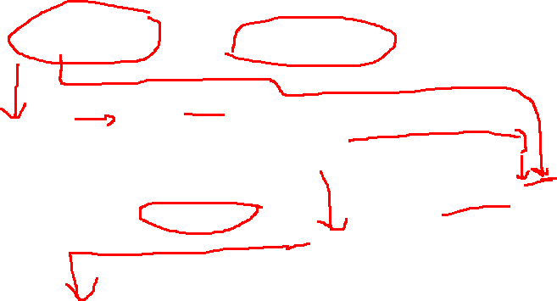
Sequence Diagram
Refresher
ObjectA ObjectB Object C
Read Direction
function( params )
function() params
Currently on the stack
No Return Val
Return Val

Slide 21
Scenario
How is it used?

Slide 22
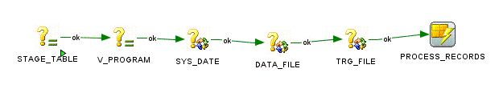
Scenario
Getting more details since a description is rarely enough
A scenario is a particular task or job the system needs to do
It given more detail to the problem
Scenarios can result in more classes, functions, and links

Slide 23

A Scenario
Player one, named Bob, chooses the color of their pieces to be blue.
You may notice that some information is missing. That's normal. One scenario will not catch everything. Most of the time something will be missing. A scenario could also ADD info!
We now have a player class with variables!
How does it connect?

Slide 24
New version
Player
name : string
CheckersProgram
Has 2
Piece
color : boolean
Has 1
Has 0..1
Has 0..12
Board
King
Square
color : Color
Has 64

Slide 25
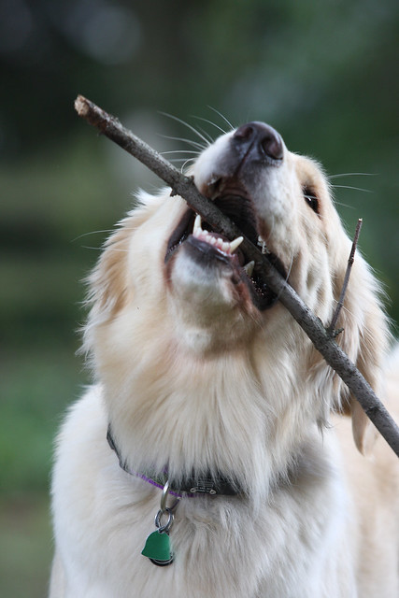
Functions?
We haven’t really seen these yet. We would have to guess or use scenarios
First rule, do NOT add getters/setters
In a real-world system, GUESS or ask your client
AGAIN, for example problems in this class, do NOT guess unless explicitly told to. Don’t make more work for yourself.
A scenario may give some very clear functions though

Slide 26
Functions from scenarios
The scenario gave this task:
A player chooses a piece color
We need to add the functions we think we need to do this…

Slide 27
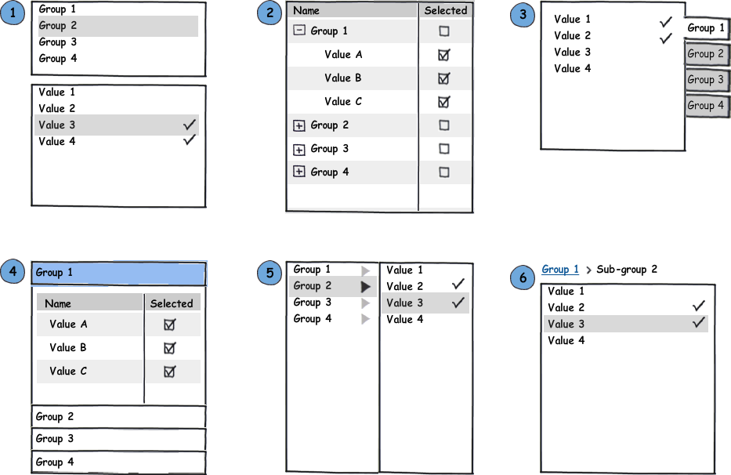
Functions
Where do we need to start this process?
CheckerProgram: we need to start the change. This call is internal, but they do not have to be..
Add getPlayer() : Player

Slide 28
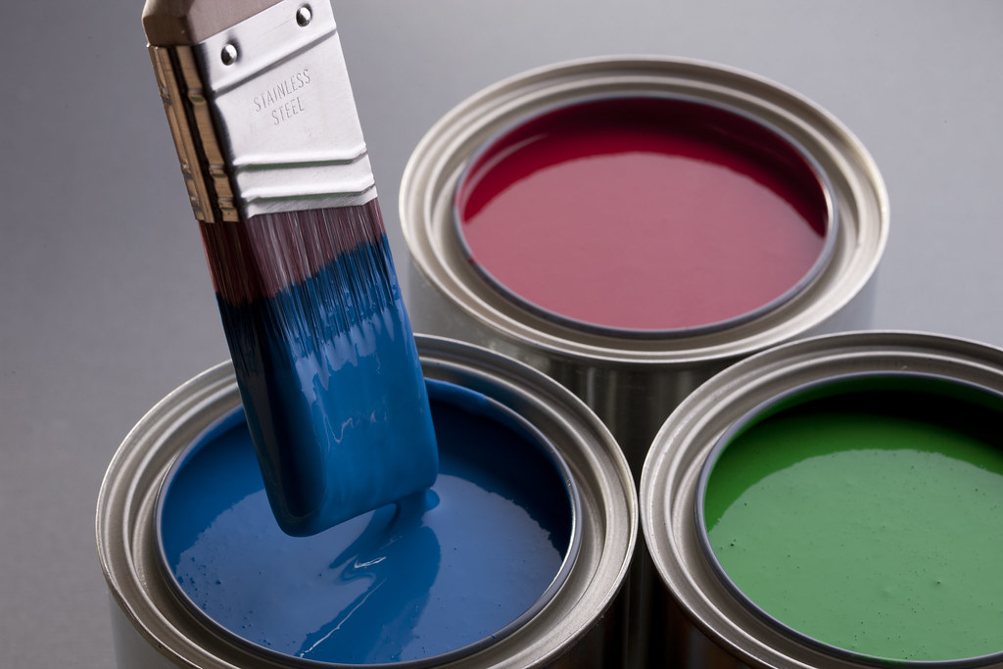
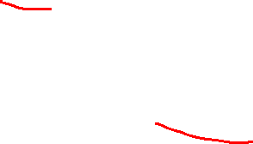
Functions
What is next?
The player needs to set the color of all of its pieces.
Add color() : void
Next would be setColor(color : Color) in Piece, but we do not add those to the diagram.

Slide 29
Functions
To “check” if a tasks can be accomplished, either
Trace through the class diagram
Make a sequence diagram

Slide 30
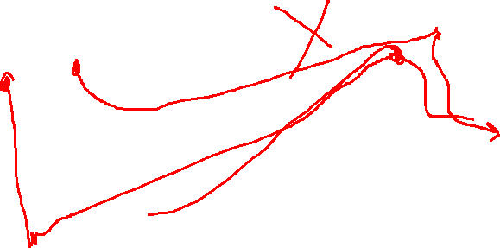
Functions
Player
name : string
color() : void
Has 2
CheckersProgram
getPlayer() : Player
Piece
color : boolean
Has 1
Has 0..1
Has 0..12
Board
King
Square
color : Color
Has 64

Slide 31
Sequence diagram
CheckersProgram Player: Red Piece: 1 Piece: 2 … Piece: 6
getPlayer( )
red
color()
setColor(blue)
setColor(blue)
setColor(blue)
This is minimal. Sending in the color also makes sense.

Slide 32
Recap
Diagramming give a high-level overview of our problem
Decomposition
Classes, variables → nouns
Links → verbs
Multiplicity → adverbs (commonly)
Notation
How to handle scenarios
How to handle functions

